Slide 1
Team: PEXAX Product: Beltexit hack.İstanbul, 02.12.2018

Slide 2

What do you see?
Let's start with a video before we get to the presentation

Slide 3
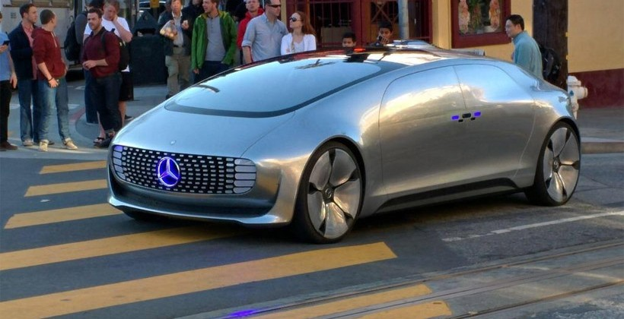
Futuristic design
1- Autonomous appealing to the future.

Slide 4
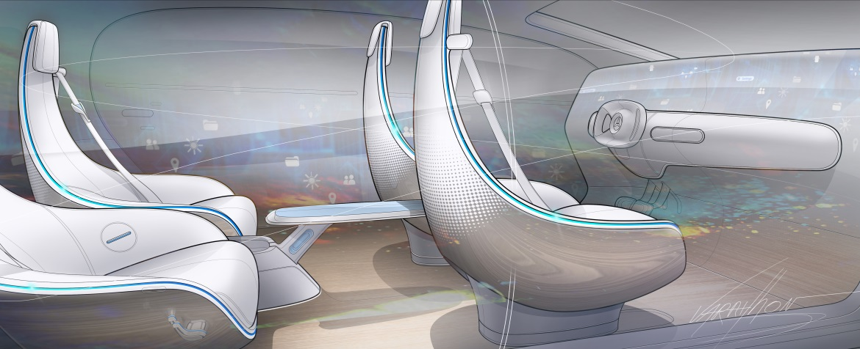
Inner design
3- Huge distance between seats and cockpit.

Slide 5
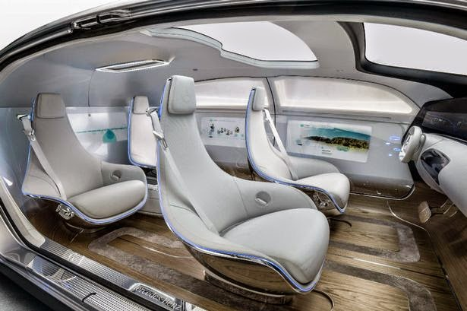
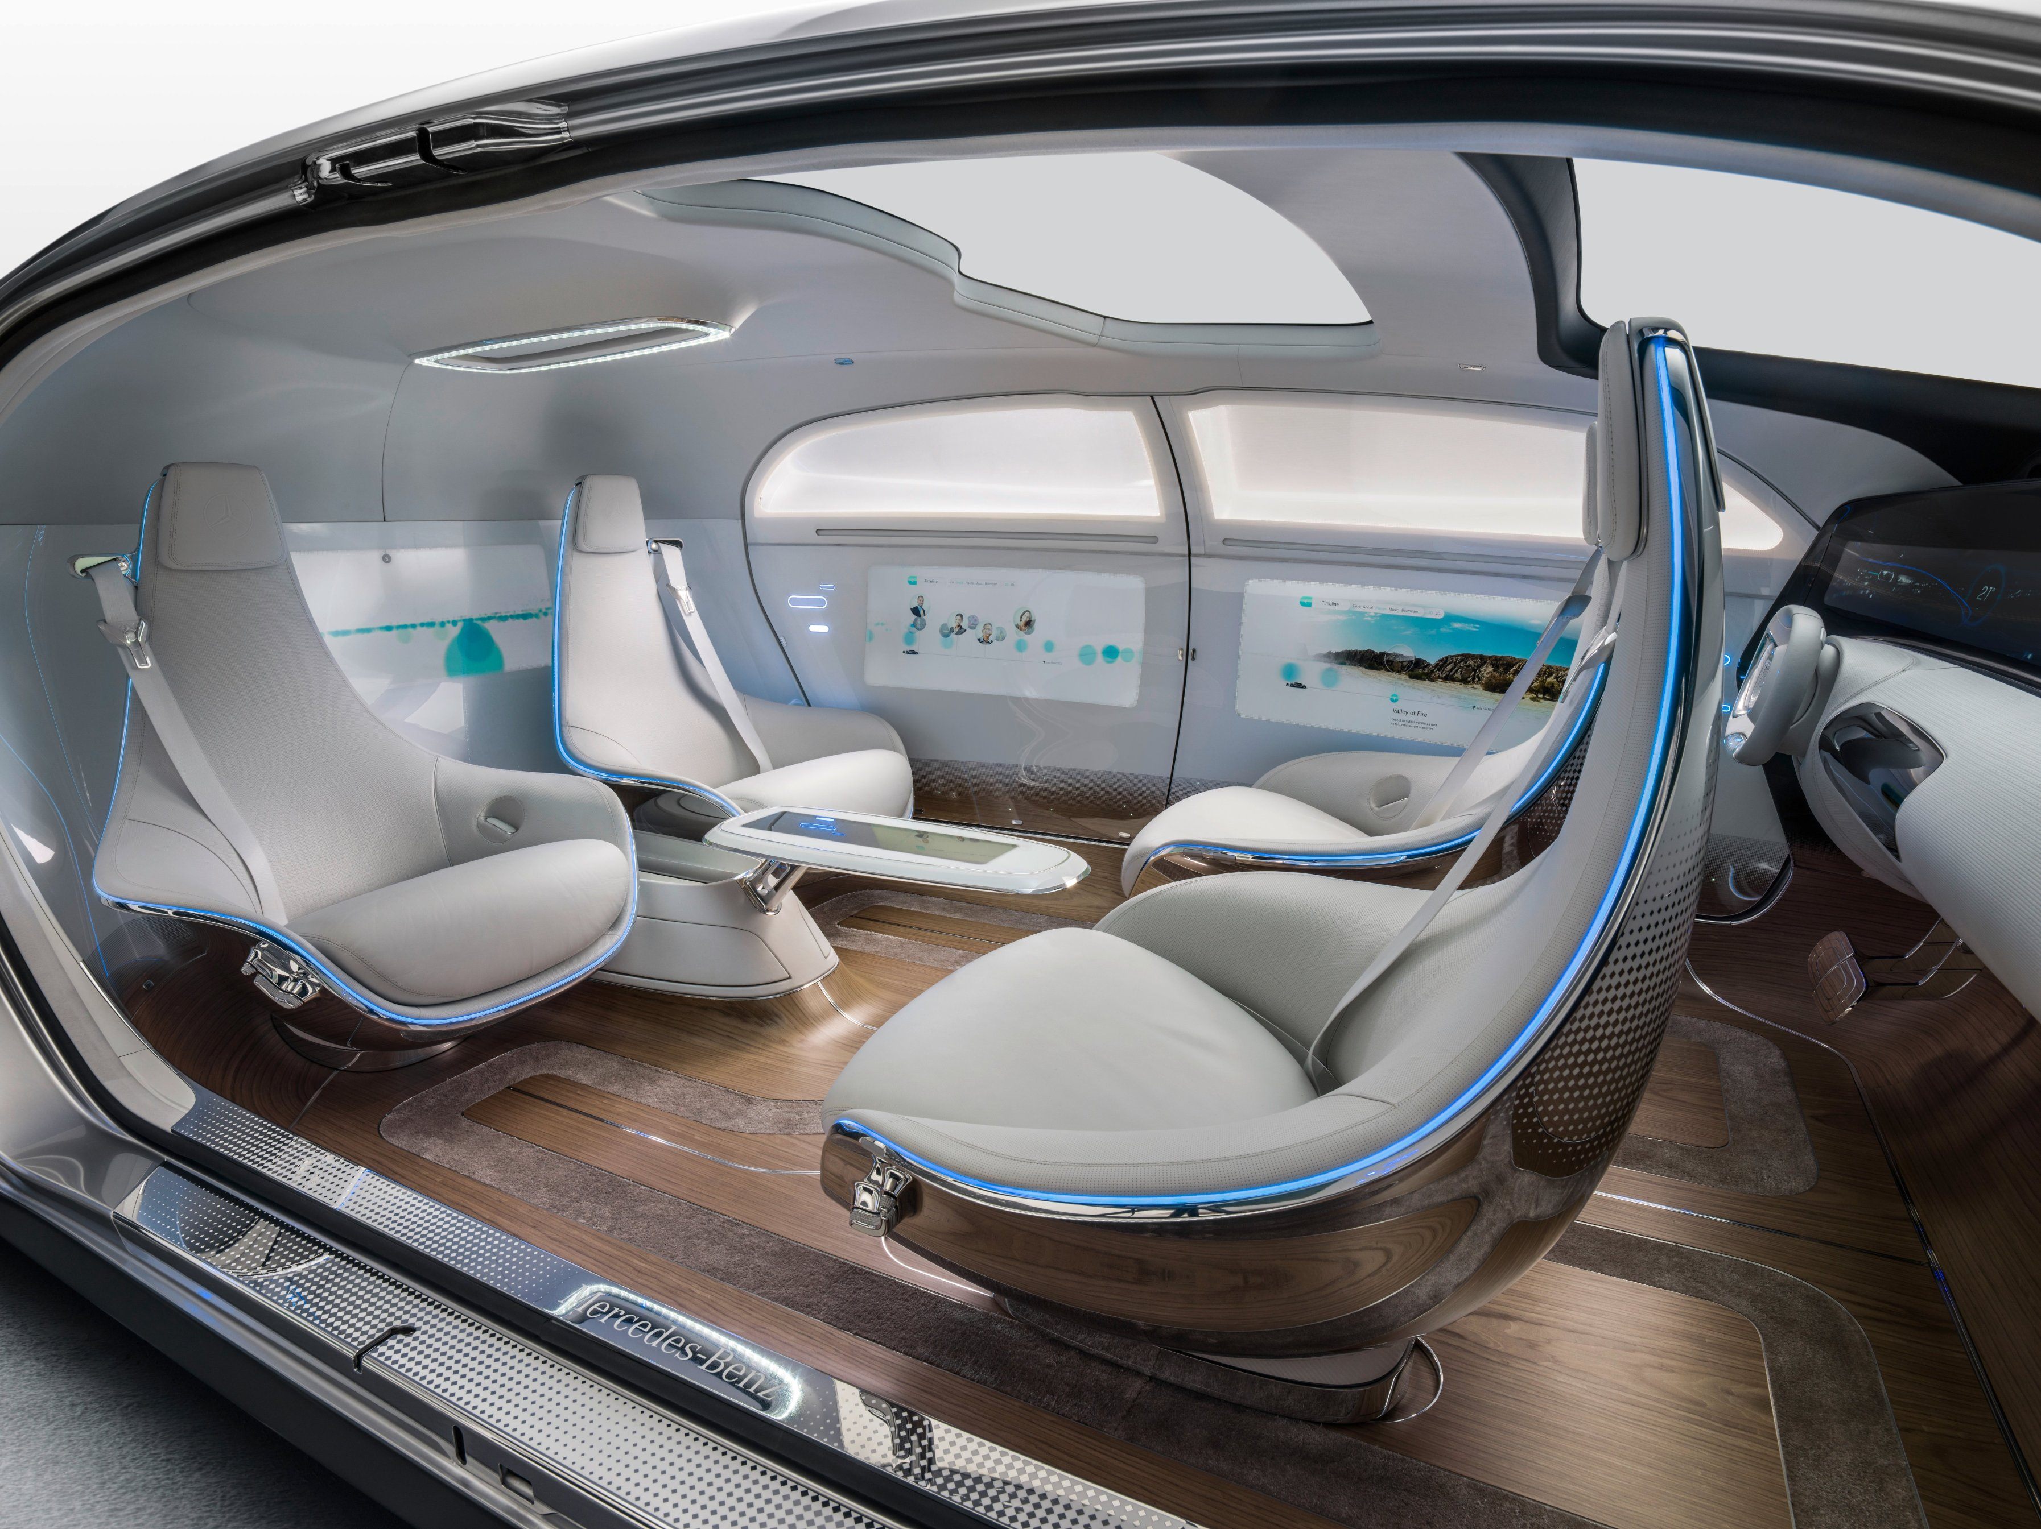
Flexible seat construction
2 – 180° degrees rotatable seats

Slide 6
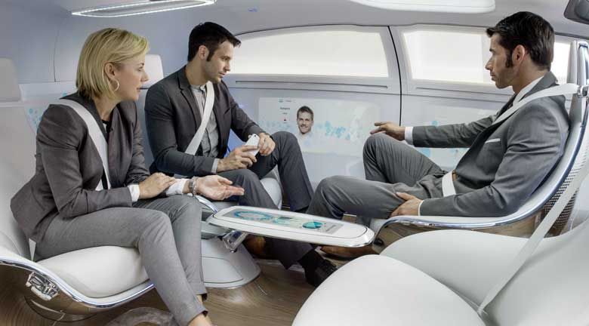
Old fashioned
4 - And very primitive seat belt

Slide 7
Removing old fashioned belt completely in futuristic cars with guaranteeing safety & comfort

Slide 8
Intelligent seats

Slide 9
When unexpected moments are happening (e.g.: sudden brake), our smart seats keep moving with acceleration of the car and grasping passengers like a baseball glove for their safety.

Slide 10
Scenario
The autonomous vehicle can predict an accident and make sudden braking
Someone who doesn't wear a seat belt could probably be thrown out with this sudden brake
With our idea «beltexit» will protect passengers without using a seat belt.

Slide 11
Simulation
Let’s have a look.

Slide 12
Physical background

Slide 13

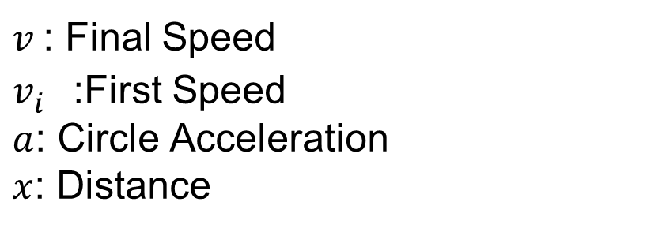
Linear motion
$$v=v_{i}^{2}+2ax$$
$v$: Final Speed
$v_{i}^{}$:First Speed
$a$: Circle Acceleration
$x$: Distance

Slide 14

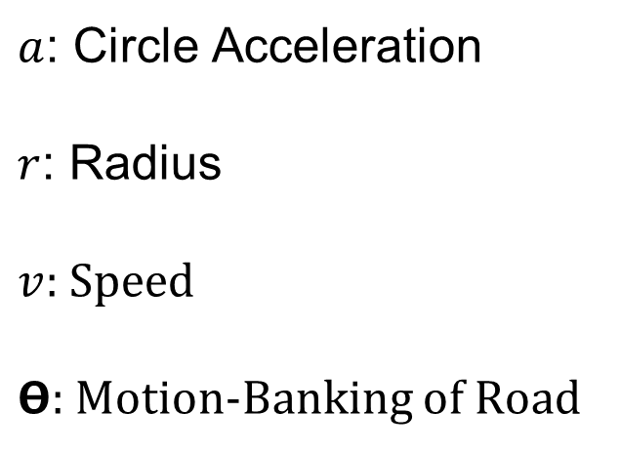
Circle motion
$a$: Circle Acceleration
$r$: Radius
$v$: Speed
$Θ$: Motion-Banking of Road
$$a=\frac{v^{2}}{r}$$
$$\tan{Θ}=\frac{v^{2}}{rg}$$

Slide 15
Technical background

Slide 16



$$Azure \left(cloud\right)Database$$
$$Cloud IP Service$$
$$.Net Form Applications$$
Features:
IoT

Slide 17
We protect
High security
When autonomous vehicle predicts an accident or unexpected accident happens, it will rotate the seats to the opposite direction of where the crash comes from.

Slide 18
we provide comfort
Passenger car drivers dont wants to use uncomfortable seat belts. But they feel forced to the use.
We promise you a seat belt-free and safe travel with our idea.

Slide 19
Thanks!

